Slide 1
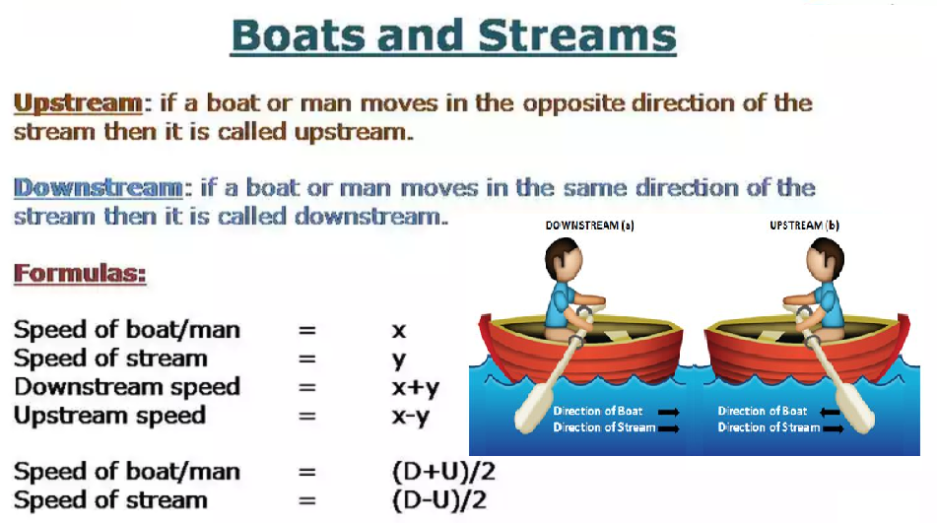

Slide 2
Practice Questions:
1. A man's speed with the current is 15 km/hr and the speed of the current is 2.5 km/hr. The man's speed against the current is:
A. 8.5 km/hr
B. 9 km/hr
C. 10 km/hr
D. 12.5 km/hr
Notes:
c

Slide 3
2. Boat goes downstream from P to Q in 2hrs, upstream in 6hrs and if speed of stream is 6km/h, then find the distance PQ
6 km
4 km
10 km
36 km
Notes:
D – easier using ratio -const D

Slide 4
3. A river runs at 4 km/hr. if the time taken by a man to row is boat upstream is thrice as the time taken by him to row it downstream then find the speed of the boat in still water.
16 km/hr
8 km/hr
6 km/hr
12 km/hr
Notes:
B

Slide 5
4. A motorboat whose speed is 15 km/h in still water goes 30 km downstream and comes back in a total of 4hrs 30min. What is the speed of the stream?
5 km/h
6 km/h
10 km/h
12 km/h
Notes:
A

Slide 6
5. A boat sails 15 km of a river towards upstream in 5 hours. How long will it take to cover the same distance downstream, if the speed of current is one-fourth the speed of the boat in still water:
1.8 h
3 h
4 h
5 h
Notes:
B

Slide 7
6. A man can row a certain distance against the stream in six hours. However, he would take two hours less to cover the same distance with the current. If the speed of the current is 2 Km/h, then what is the speed of the man in still water.
10 km/h
12 km/h
16 km/h
8 km/h
Notes:
A

Slide 8
7. A man can row downstream at 12 Km/h and upstream at 8 Km/h. Find the ratio of the speed of the current to the speed of the man in still water?
1 : 5
5 : 4
25 : 16
16 : 25
Notes:
A

Slide 9
8. In a stream running at 2 km/h, a motorboat goes 10 km upstream and returns to the starting point in 55 minutes. Find the speed (all in km/h) of the motorboat in still water.
2
11
22
None of these
Notes:
C

Slide 10
9. The ratio of the speed of the boat in still water to the speed of the current is 4:1. What is the ratio of the downstream speed of the boat to the upstream speed?
2:1
1:1
5:3
None of these
Notes:
C

Slide 11
10. A boatman rows to a place at a distance 45 km and comes back in 20 hours. He finds that he can row 12 km with the stream in the same time as 4 km against the stream. Find the speed of the stream.
3 km/h
2.5 km/h
4 km/h
3.5 km/h

Slide 12
11. Two boats, travelling at 5 km/h and 10 km/h respectively, head directly towards each other. They begin at a distance of 20 km from each other. How far apart are they (in km) one minute before they collide?
1/12
1/6
1/4
1/3

Slide 13
12. A man takes twice as long to row a distance against the stream as to row the same distance along the stream. The ratio of the speed of the boat (in still water) and the stream is
2:1
3:1
3:2
4:3

Slide 14
13. A man takes a total time of 2hours to cover a distance of 6 km while doing upstream and downstream. If the speed of stream is 4 km/h find speed of boat in still water?
2 km/h
6 km/h
3 km/h
8 km/h

Slide 15
14. While going A to B against the stream and coming back from B to A with stream it takes a total time of 3 hours. If the distance from B to A is 4 km and speed of stream is 1 km/h. Find speed of boat in still water?
2 km/h
4 km/h
3 km/h
1 km/h

Slide 16
15. The speed of boat A is 2 km/hr less than the speed of boat B. The time taken by boat A to cover a distance of 20 Km downstream is 30 min more than the time taken by B to cover the same distance downstream. If the speed of the current is one-third of the speed of boat A, what is the speed of boat B?
9 kmph B. 8 kmph C. 7 kmph D. 6 kmph
E. None of these

Slide 17
16. A boat goes to a place 60 km distant and comes back in 35 hours. If it takes equal time to row 4 km with the stream that it takes to row 3 km against the stream. Find the average of the speed in still water and speed in stream?
A. 3 km/h B. 1.5 km/h C. 2 km/h D. 2.5 km/h E. None of these

Slide 18
17. A boat running upstream takes 10 hours to cover a certain distance, while it takes 6 hours 40 minutes to cover the same distance running downstream. What is the ratio between the speed of the boat in upstream to the speed of the boat in still water respectively?
A. 5 : 3 B. 3 : 5 C. 5 : 4 D. 4 : 5 E. None of these

Slide 19
18. Speed of boat in still water is x km/hr and the speed of the stream is y km/hr. It can cover 52 km downstream and 35 km upstream in 9 hours. Find the value of y if the boat can cover 63 km upstream and 78 km downstream in 15 hours
A. 13 kmph B. 10 kmph C. 7 kmph D. 6 kmph E. None of these

Slide 20


